Slide 1
Covid-19 Analysis WASHINGTON state and US
Balaji Avvaru

Slide 2
Data Set
Response Variable
Exogenous Variables
Response Variable: New positive cases in Washington state and USA
Daily observations from 01/22/2020 to 07/25/2020 for Washington state with 186 observations
Daily observations from 01/22/2020 to 07/25/2020 for US with 186 observations
An additional exogenous variables were also collected.
Contained cumulative positive cases, cumulative negative cases, cumulative deaths
Mobility data which consists of Trips by Distance and number of people staying home and not staying home
Positive percentage measure created
COVID Data was collected from the COVID tracking project https://covidtracking.com/data/download
Mobility data collected from https://data.bts.gov/Research-and-Statistics/Trips-by-Distance/w96p-f2qv

Slide 3
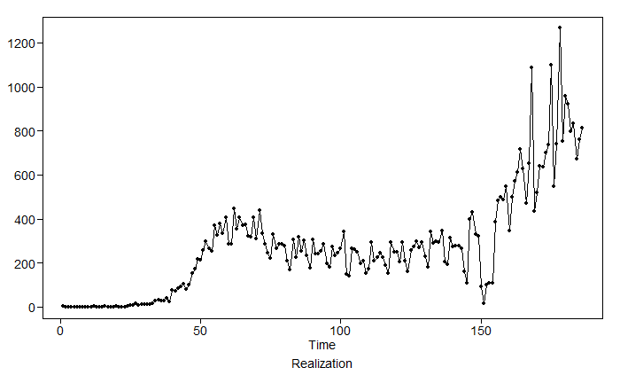
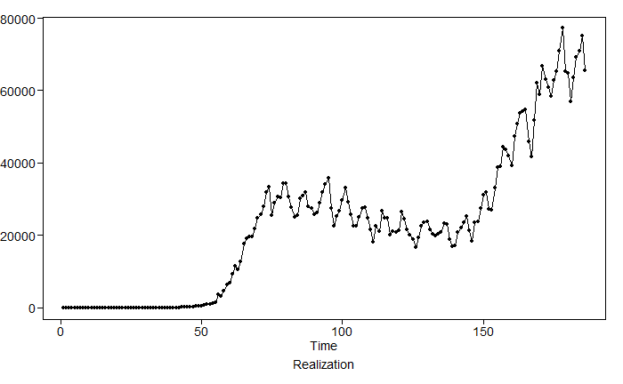
EDA
There is an upward trend now, for better forecasting, instead of taking entire data, latest data used for analysis and modeling (from 06/01/2020 to 07/25/2020).
Since not many testing's done during initial phase of the pandemic, we can see one kind of correlation structure at beginning and another correlation structure in the middle and third correlation structure now as there are many testing's in WA state and across US and accurate reporting of most of new cases or tests
WA State Realization
US Realization

Slide 4
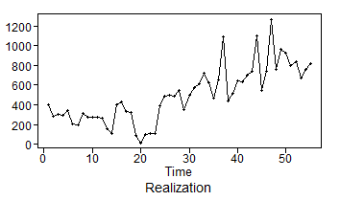
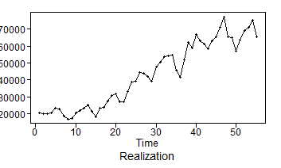
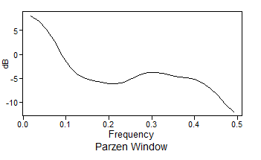
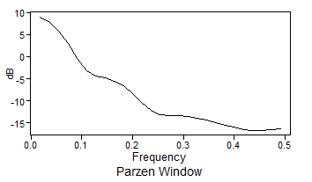
EDA: Checking Stationarity
WA State Realization
US Realization
Condition 1: Mean does not depend on time
The spectral density shows a high peak at 0, which could be generated by a stationary or non-stationary process.
Since the mean appears to change over time, this suggests a non-stationary process.
There appears to be a upward trend in the realization.

Slide 5
EDA: Checking Stationarity
Condition 2: Variance does not depend on time
Since only one realization is possible, it is difficult to assess the realization variance.
However, there is more volatility in the second half than in the first half.
This may be an indication of non-constant variance, which would suggest a non-stationary process, but again difficult to say with just one realization.
WA State Realization
US Realization

Slide 6
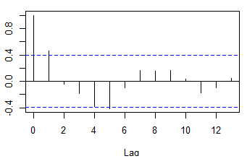
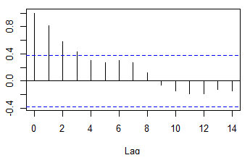
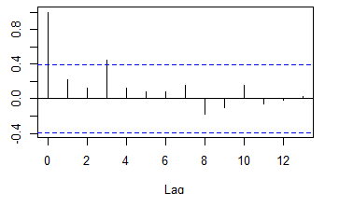
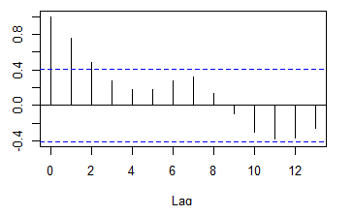
EDA: Checking Stationarity
WA First half
US First half
Condition 3: The correlation of $X_{t_{1}}$ and $X_{t_{2}}$ depends only on $t_{2}−t_{1}$
Condition 3: The correlation of 𝑿_(𝒕_𝟏 ) and 𝑿_(𝒕_𝟐 ) depends only on 𝒕_𝟐−𝒕_𝟏
The ACFs of the first half and second half exhibit different characteristics for Washington State.
More exponentially damped autocorrelations and no hints of seasonality in the first half of the data for US.
This may suggest a non-stationary process, though the evidence is weak.
A hint of seasonality in second half of the data though it is not appreciable for US
WA Second half
US Second half

Slide 7
EDA: Checking Stationarity
Conclusion
We will continue the analysis modeling the COVID data using univariate analysis and multivariate analysis to forecast number of new cases in Washington state and US.
Based on the analysis, there appears to be some evidence that the process is non-stationary for both Washington state and US.

Slide 8
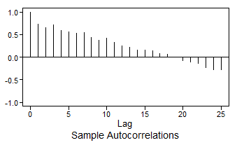
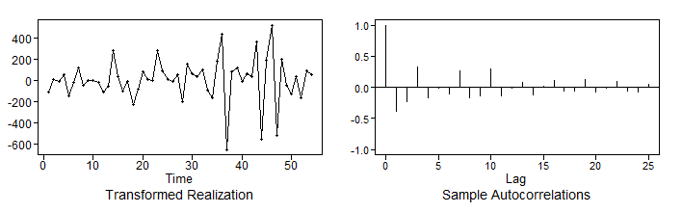
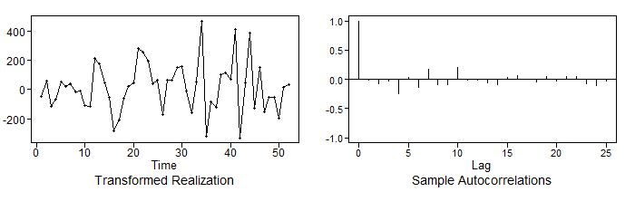
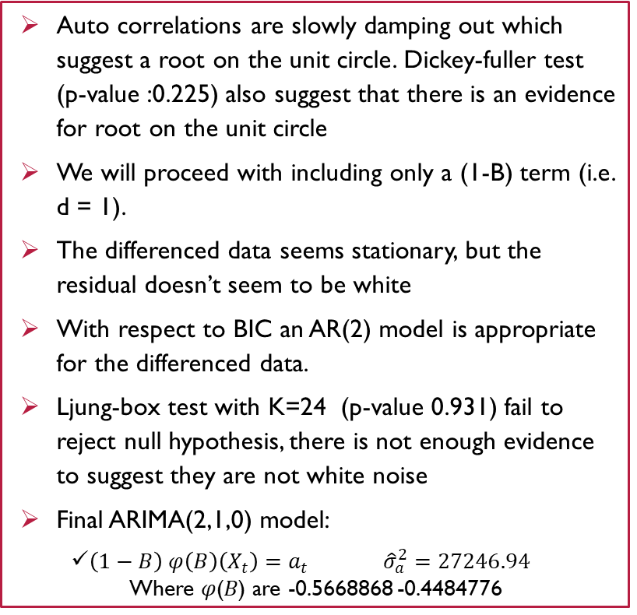
WA State – Univariate ARIMA model
Auto correlations are slowly damping out which suggest a root on the unit circle. Dickey-fuller test (p-value :0.225) also suggest that there is an evidence for root on the unit circle
We will proceed with including only a (1-B) term (i.e. d = 1).
The differenced data seems stationary, but the residual doesn’t seem to be white
With respect to BIC an AR(2) model is appropriate for the differenced data.
Ljung-box test with K=24 (p-value 0.931) fail to reject null hypothesis, there is not enough evidence to suggest they are not white noise
Final ARIMA(2,1,0) model:
$\left(1−B\right) φ\left(B\right)\left(X_{t}\right)=a_{t} {\hat{σ}}_{a}^{2}=27246.94$
Where 𝜑(𝐵) are -0.5668868 -0.4484776
Realization and ACF with first differenced data
Realization and ACF with AR(2) on first differenced data

Slide 9
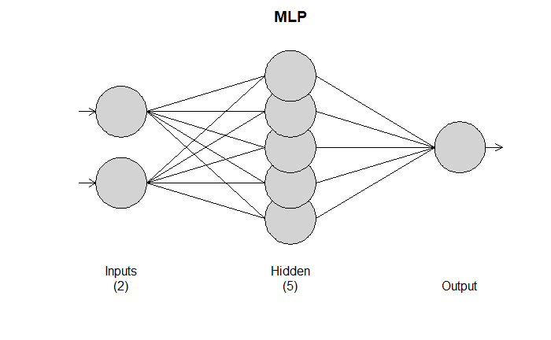
WA State – Univariate MLP model
Hyper parameter:
MLP fit with 5 hidden nodes and 100 repetitions.
Univariate lags: (1,3)
Forecast combined using the median operator.
MSE: 14323.5885.

Slide 10
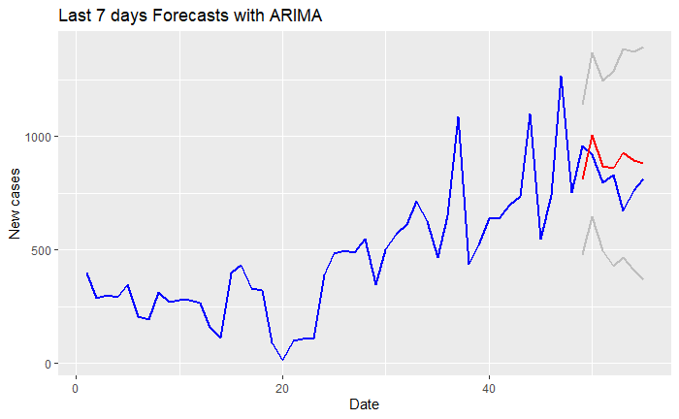
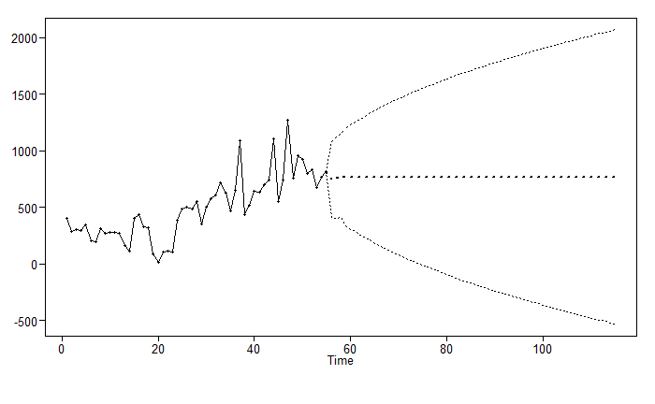
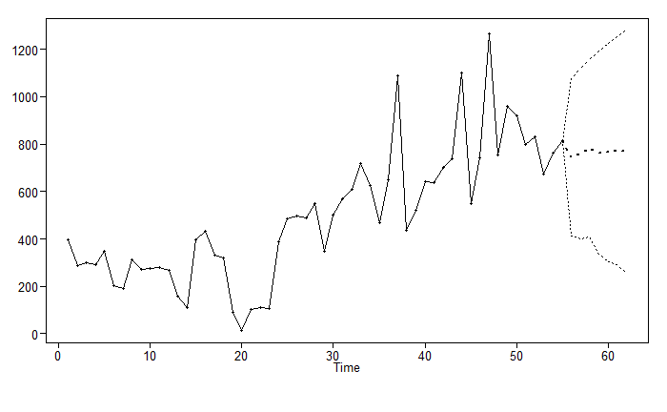
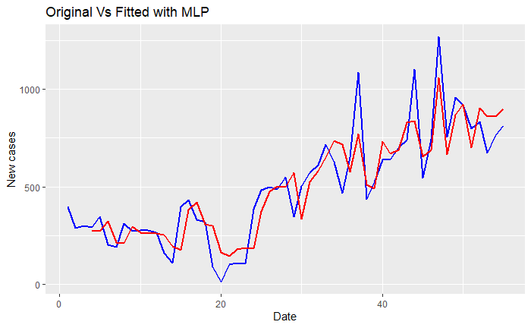
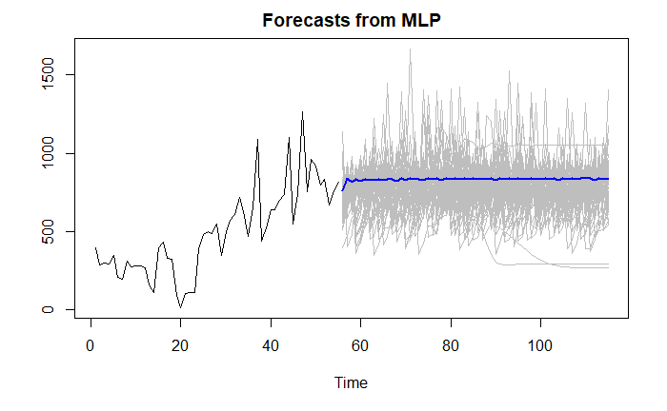
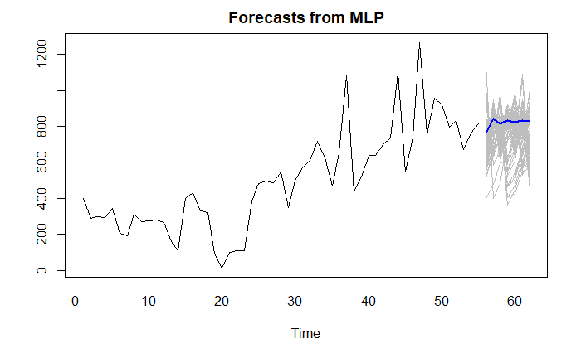
WA State – Univariate Model Comparison
ASE Comparison
FORECASTS Comparison
ARIMA(2,1,0) model
Rolling window ASE with ARIMA model : 57425.35
Long term (next 60 days) Forecasts
Short term (next 7 days) Forecasts
Rolling window ASE with MLP model : 13239.29
MLP model
Long term (next 60 days) Forecasts
Short term (next 7 days) Forecasts

Slide 11
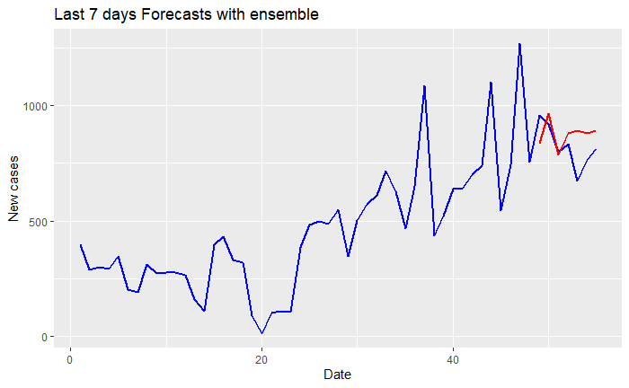
WA State – Univariate ensemble Model
Ensemble model is average forecasts of ARIMA and MLP models
Rolling window ASE with ensemble model : 35332
With univariate, MLP model shows the best performance with respect to ASE
For short term forecasts, MLP model can be used as it is following the latest trend

Slide 12
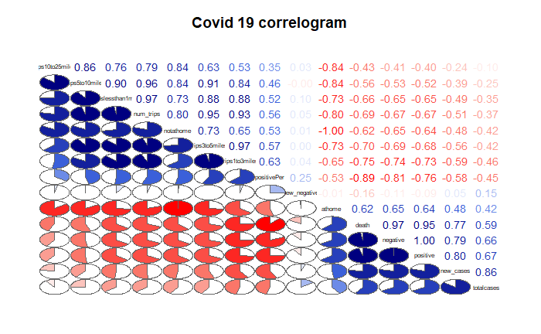
WA State – Multivariate analysis
New cases is correlated to total cases
New cases is correlated with trips between 3 to 5 miles
New cases is correlated with trips between 1 to 3 miles
New cases is correlated with trips less than 1 mile
All mobility variables are correlated with number of new cases, but all of them are highly correlated with each other, including them in the model might result in multicollinearity issue. So decided to include one of the highly correlated mobility variable in the model.
Using total number of cases and also trips between 1 to 3 miles as exogenous variable to forecast number of new cases

Slide 13
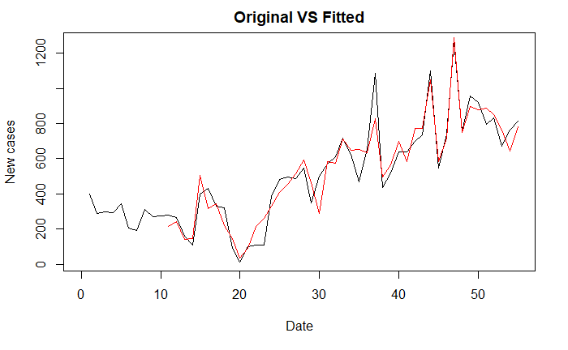
WA State – Multivariate VAR model
Use VARselect and AIC to select the maximum lag to consider for various trend types
Fit the model with selected lag from VARselect
VAR model with p =10 capture the trend of the realization

Slide 14
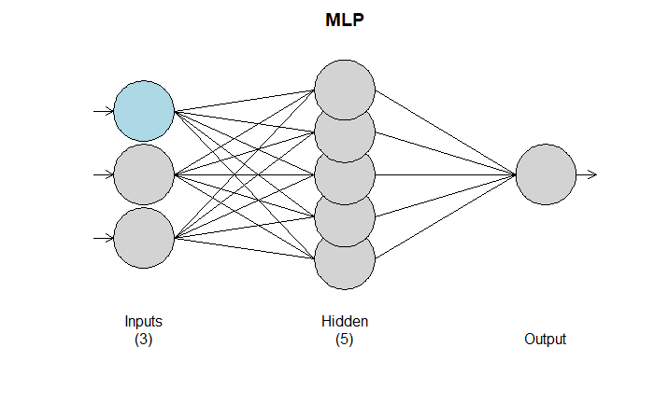
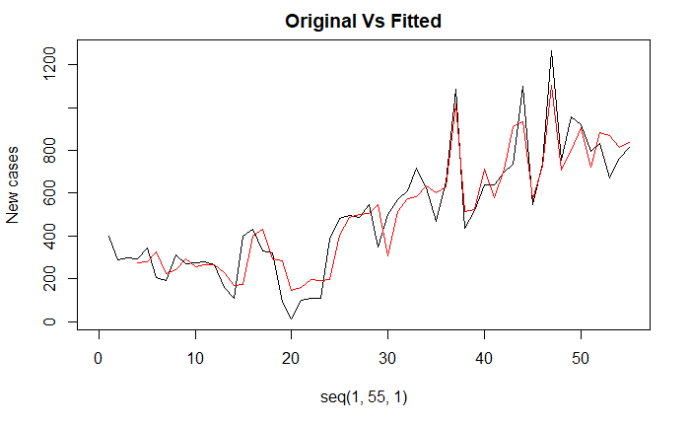
WA State – Multivariate MLP model
MLP fit with 5 hidden nodes and 100 repetitions.
Univariate lags: (1,3)
1 regressor included.
- Regressor 1 lags: (1)
Forecast combined using the median operator.

Slide 15
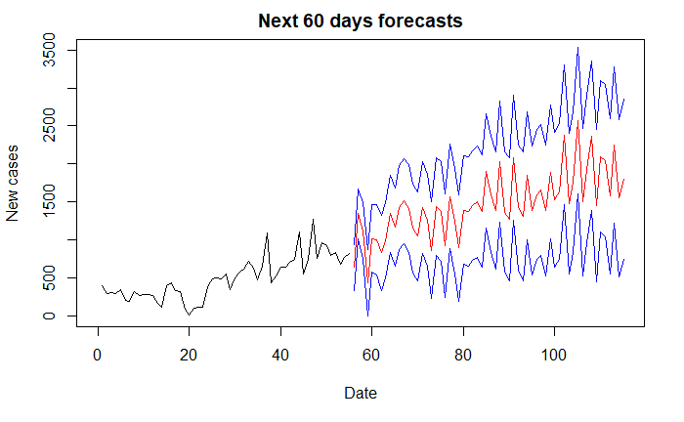
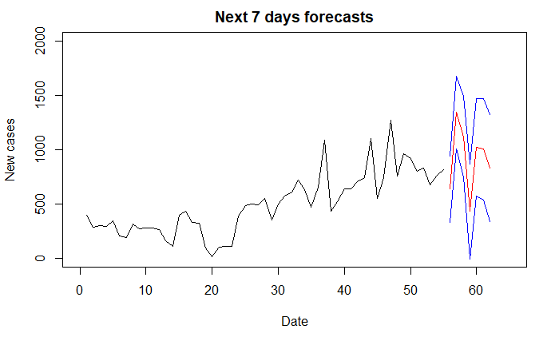
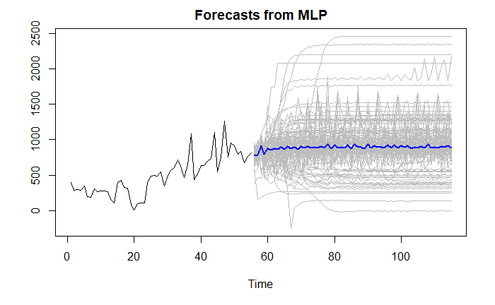
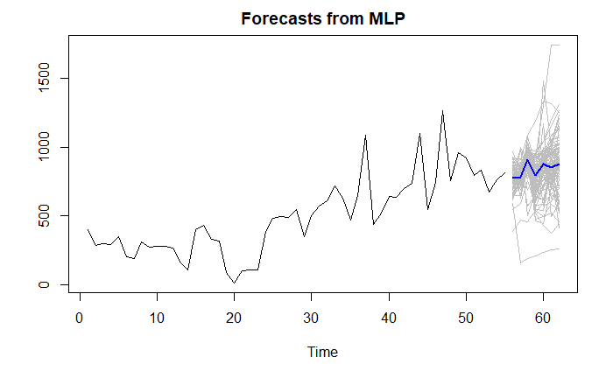
WA State – Multivariate Model Comparison
ASE Comparison
FORECASTS Comparison
VAR model
Rolling window ASE with VAR model : 6966.21
Long term (next 60 days) Forecasts
Short term (next 7 days) Forecasts
Rolling window ASE with MLP model : 9884.547
MLP model
Long term (next 60 days) Forecasts
Short term (next 7 days) Forecasts

Slide 16
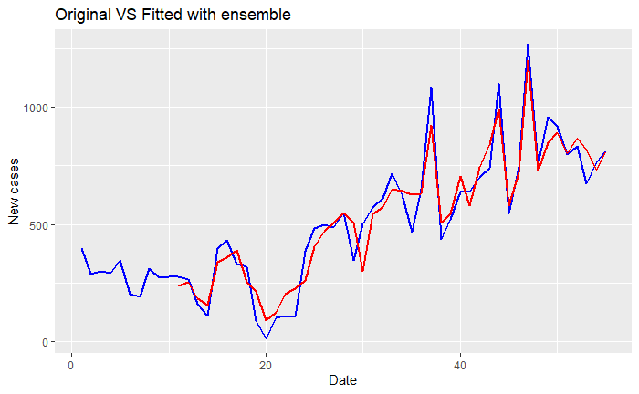
WA State – Multivariate ensemble Model
Ensemble model is average of VAR and MLP models
Rolling window ASE with ensemble model : 6524.279
With multivariate, Ensemble of VAR and MLP model shows the best performance with respect to ASE
For short term forecasts, Ensemble model can be used as it is following the latest trend

Slide 17
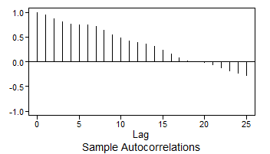
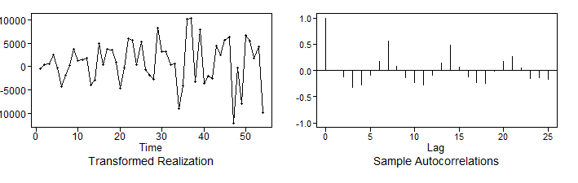
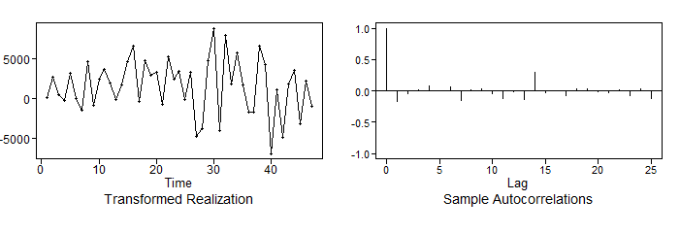
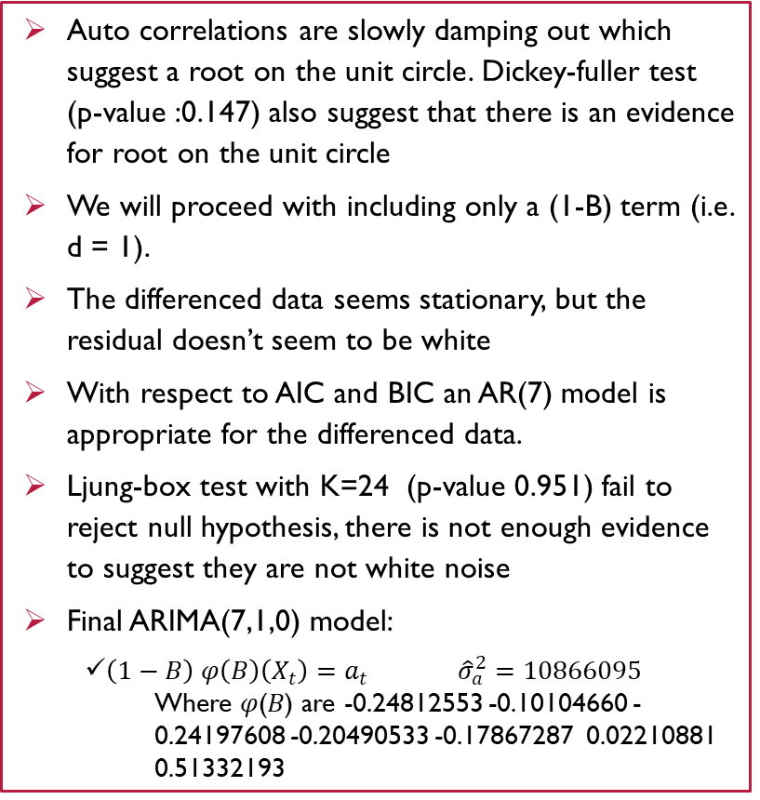
US – Univariate ARIMA model
Auto correlations are slowly damping out which suggest a root on the unit circle. Dickey-fuller test (p-value :0.147) also suggest that there is an evidence for root on the unit circle
We will proceed with including only a (1-B) term (i.e. d = 1).
The differenced data seems stationary, but the residual doesn’t seem to be white
With respect to AIC and BIC an AR(7) model is appropriate for the differenced data.
Ljung-box test with K=24 (p-value 0.951) fail to reject null hypothesis, there is not enough evidence to suggest they are not white noise
Final ARIMA(7,1,0) model:
$\left(1−B\right) φ\left(B\right)\left(X_{t}\right)=a_{t} {\hat{σ}}_{a}^{2}=10866095$
Where 𝜑(𝐵) are -0.24812553 -0.10104660 -0.24197608 -0.20490533 -0.17867287 0.02210881 0.51332193
Realization and ACF with first differenced data
Realization and ACF with AR(7) on first differenced data

Slide 18
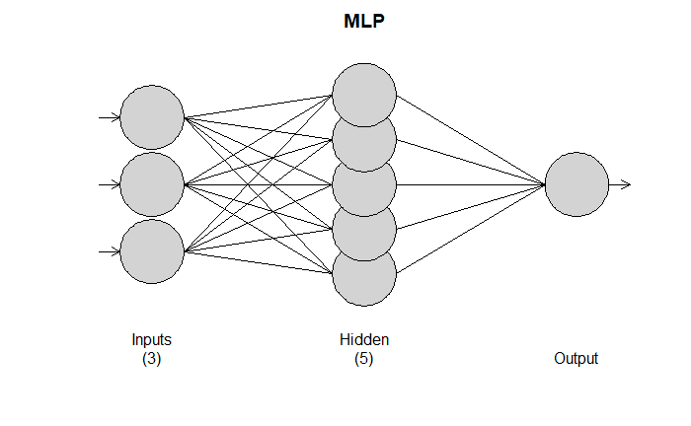
US – Univariate MLP model
Hyper parameter:
MLP fit with 5 hidden nodes and 100 repetitions.
Univariate lags: (1,3,4)
Forecast combined using the median operator.

Slide 19
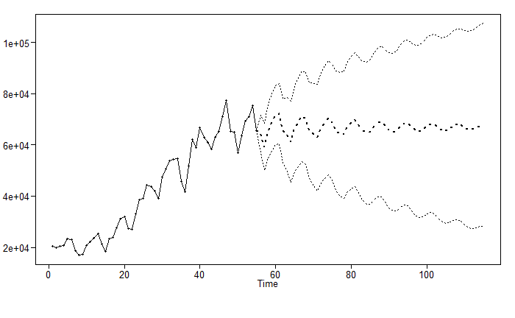
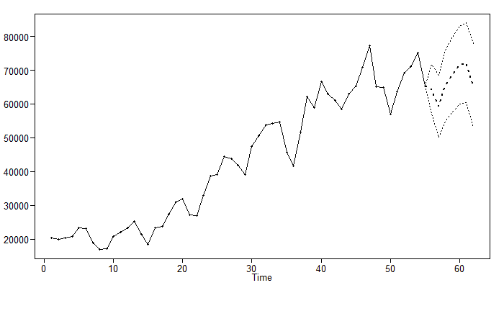
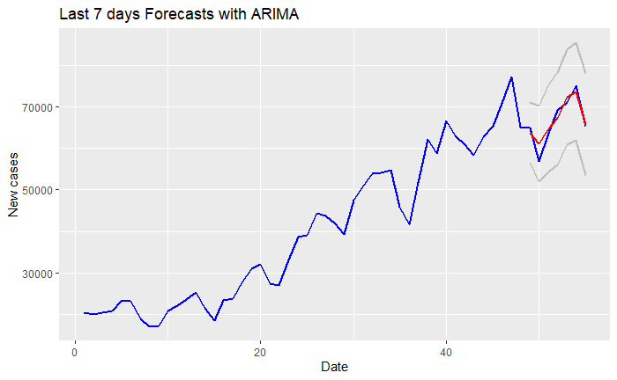
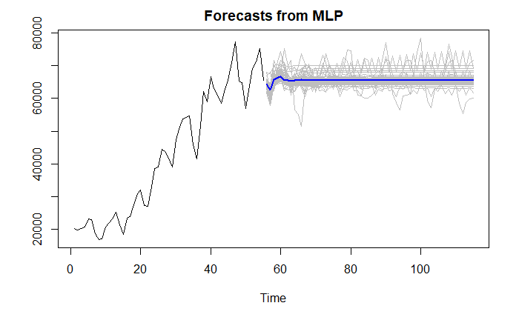
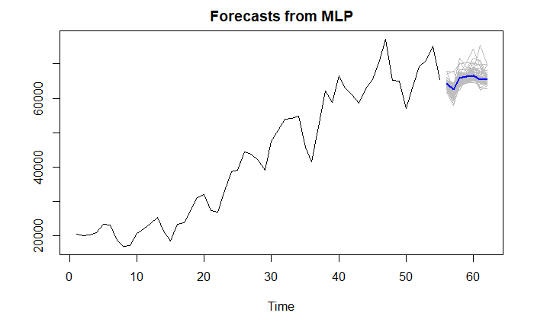
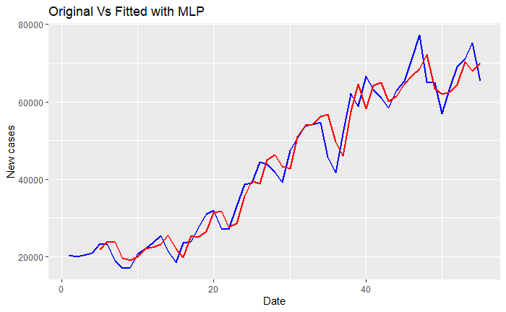
US – Univariate Model Comparison
ASE Comparison
FORECASTS Comparison
ARIMA(7,1,0) model
Rolling window ASE with ARIMA model : 50233680
Long term (next 60 days) Forecasts
Short term (next 7 days) Forecasts
MLP model
Rolling window ASE with MLP model : 17558949
Long term (next 60 days) Forecasts
Short term (next 7 days) Forecasts

Slide 20
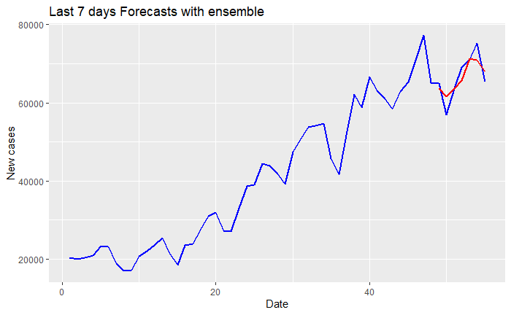
US– Univariate ensemble Model
Ensemble model is average forecasts of ARIMA and MLP models
Rolling window ASE with ensemble model : 33,896,314
With univariate, MLP model shows the best performance with respect to ASE
For short term forecasts, ARIMA(7,1,0) model can be used as it is following the latest trend

Slide 21
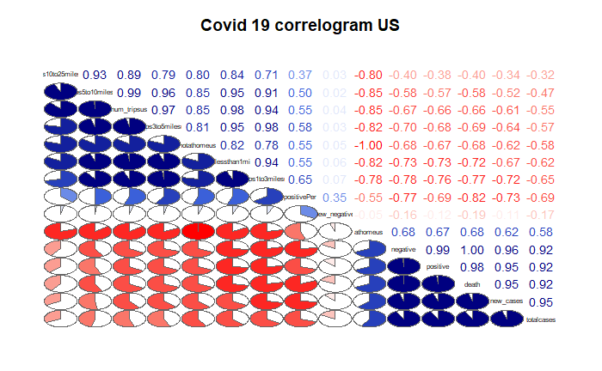
US– Multivariate analysis
New cases is correlated to total cases
New cases is correlated with trips between 3 to 5 miles
New cases is correlated with trips between 1 to 3 miles
New cases is correlated with trips less than 1 mile
All mobility variables are correlated with number of new cases, but all of them are highly correlated with each other, including them in the model might result in multicollinearity issue. So decided to include one of the highly correlated mobility variable in the model.
Using total number of cases and also trips between 1 to 3 miles as exogenous variable to forecast number of new cases

Slide 22
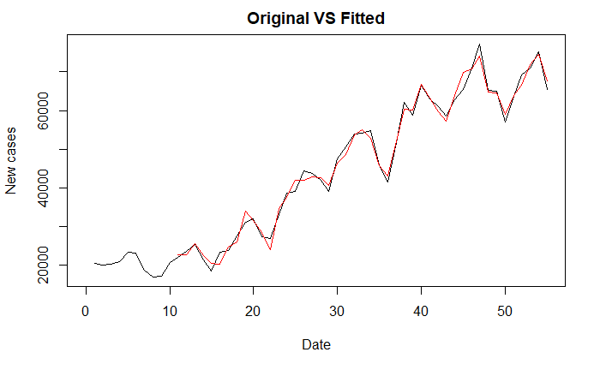
US– Multivariate VAR model
Use VARselect and AIC to select the maximum lag to consider for various trend types
Fit the model with selected lag from VARselect
VAR model with p =10 capture the trend of the realization

Slide 23
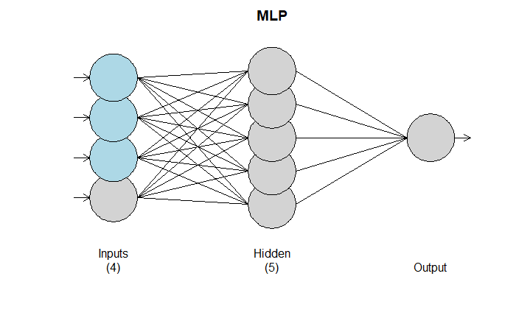
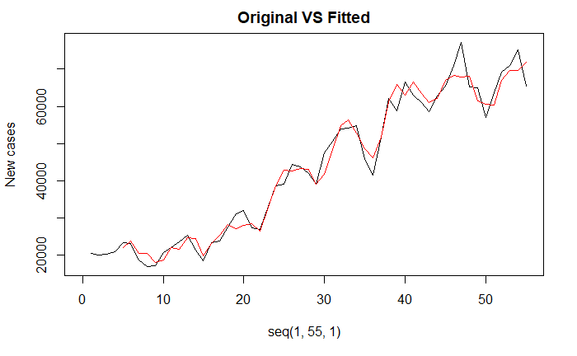
US – Multivariate MLP model
MLP fit with 5 hidden nodes and 100 repetitions.
Univariate lags: (1)
1 regressor included.
- Regressor 1 lags: (2,3,4)
Forecast combined using the median operator

Slide 24
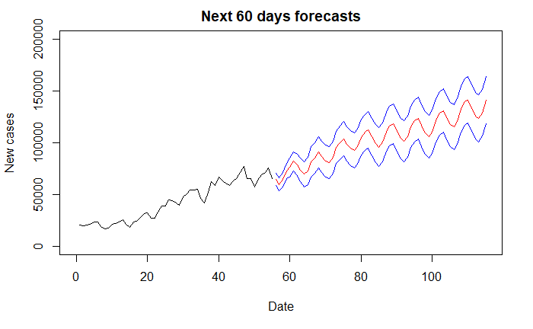
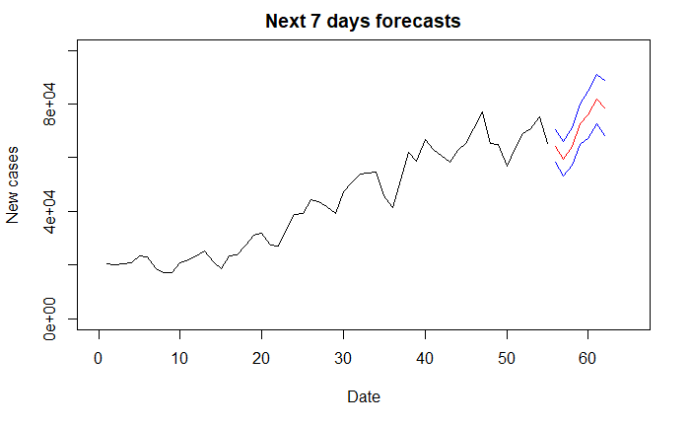
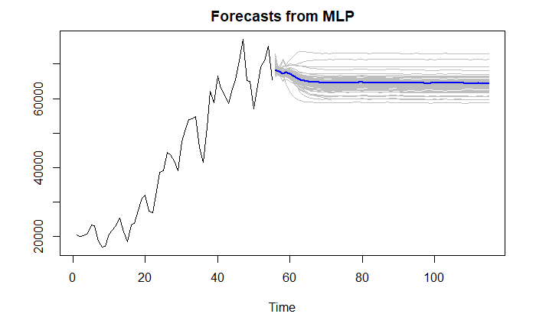

US – multivariate Model Comparison
ASE Comparison
FORECASTS Comparison
VAR model
Rolling window ASE with VAR model : 2818322
Rolling window ASE with MLP model : 9444360
MLP model
Long term (next 60 days) Forecasts
Short term (next 7 days) Forecasts

Slide 25

US– Multivariate ensemble Model
Ensemble model is average of VAR and MLP models
Rolling window ASE with ensemble model : 4543925
With univariate, VAR model shows the best performance with respect to ASE
For short term forecasts, Ensemble model can be used as it is following the latest trend

Slide 26
Conclusion
Ensemble appear to improve forecasts for Washington state and ,VAR model captures the trend of realization for US.
For short term forecasts, Ensemble model can be used for Washington state as well as US as it is following the latest trend
There are many factors influencing new COVID cases, we may not be able to use any of the models for long term forecasting
Addition of other exogenous variables with even stronger cross correlations may improve performance of multivariate models.

